Slide 1
Operators
August 6, 2009

Slide 2
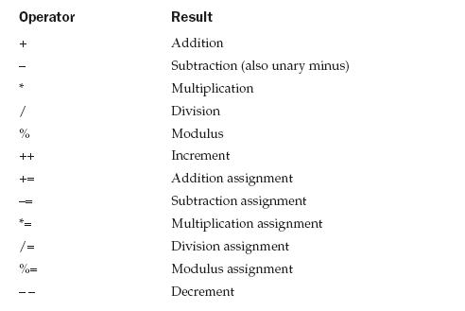
Arithmetic Operators
August 6, 2009

Slide 3
class BasicMath {
public static void main(String args[]) {
// arithmetic using integers
System.out.println("Integer Arithmetic");
int a = 1 + 1; int b = a * 3;
int c = b / 4;
int d = c - a;
int e = -d;
System.out.println("a = " + a);
System.out.println("b = " + b);
System.out.println("c = " + c);
System.out.println("d = " + d);
System.out.println("e = " + e);
// arithmetic using doubles
August 6, 2009

Slide 4
System.out.println("\nFloating Point Arithmetic");
double da = 1 + 1;
double db = da * 3;
double dc = db / 4;
double dd = dc - a;
double de = -dd;
System.out.println("da = " + da);
System.out.println("db = " + db);
System.out.println("dc = " + dc);
System.out.println("dd = " + dd);
System.out.println("de = " + de);
} }
August 6, 2009

Slide 5
The modulus operator, %, returns the remainder of a division operation
It can be applied to floating-point types as well as integer types
This differs from C/C++, in which the % can only be applied to integer types
August 6, 2009

Slide 6
class Modulus {
public static void main(String args[]) {
int x = 42;
double y = 42.25;
System.out.println("x mod 10 = " + x % 10);
System.out.println("y mod 10 = " + y % 10);
} }
When you run this program you will get the following output:
x mod 10 = 2
y mod 10 = 2.25
August 6, 2009

Slide 7
Arithmetic Assignment Operators
a = a + 4;
a += 4;
Any statement of the form
var = var op expression;
can be rewritten as
var op= expression;
August 6, 2009

Slide 8
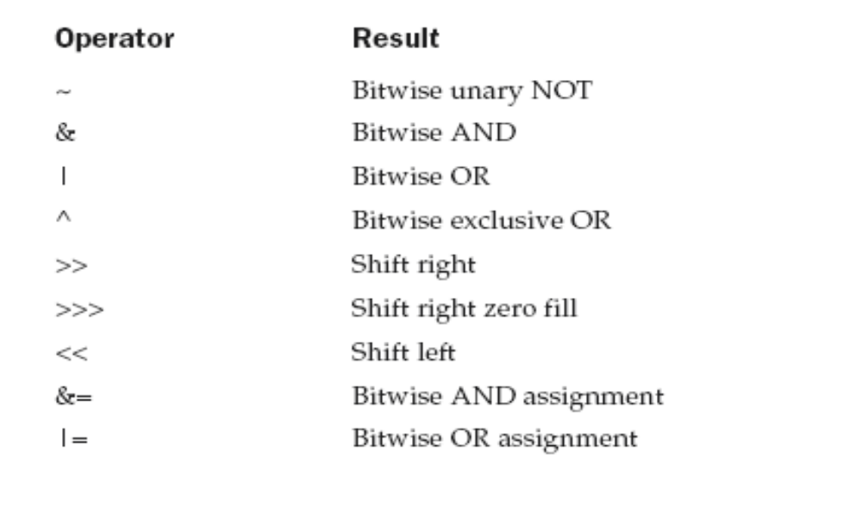
The Bitwise Operators
August 6, 2009

Slide 9
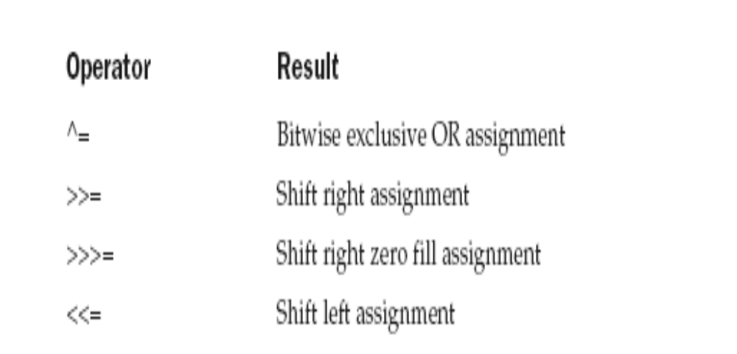
August 6, 2009

Slide 10
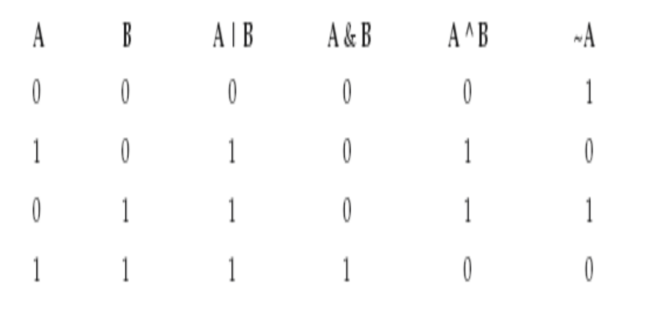
August 6, 2009

Slide 11
class BitLogic {
public static void main(String args[]) {
String binary[ ] = { "0000", "0001", "0010", "0011", "0100", "0101", "0110", "0111", "1000", "1001", "1010", "1011", "1100", "1101", "1110", "1111” };
int a = 3; // 0 + 2 + 1 or 0011 in binary
int b = 6; // 4 + 2 + 0 or 0110 in binary
int c = a | b; int d = a & b;
int e = a ^ b; int f = (~a & b) | (a & ~b);
int g = ~a & 0x0f;
System.out.println(" a = " + binary[a]);
System.out.println(" b = " + binary[b]);
System.out.println(" a|b = " + binary[c]);
System.out.println(" a&b = " + binary[d]);
August 6, 2009

Slide 12
System.out.println(" a^b = " + binary[e]);
System.out.println("~a&b|a&~b = " + binary[f]);
System.out.println(" ~a = " + binary[g]); } }
Output of the program :
a = 0011
b = 0110
a | b = 0111
a & b= 0010
a ^ b = 0101
~a&B | a&~b = 0101
~a = 1100
August 6, 2009

Slide 13
The Left Shift
It has this general form:
value << num
If you left-shift a byte value, that value will first be promoted to int and then shifted
This means that you must discard the top three bytes of the result if what you want is the result of a shifted byte value
The easiest way to do this is to simply cast the result back into a byte
August 6, 2009

Slide 14
class ByteShift {
public static void main(String args[]) {
byte a = 64, b;
int i;
i = a << 2;
b = (byte) (a << 2);
System.out.println("Original value of a: " + a);
System.out.println("i and b: " + i + " " + b);
} }
Output:
Original value of a: 64
i and b: 256 0
August 6, 2009

Slide 15
The Right Shift
The right shift operator, >>, shifts all of the bits in a value to the right a specified number of times
value >> num
int a = 32;
a = a >> 2; // a now contains 8
int a = 35;
a = a >> 2; // a still contains 8
August 6, 2009

Slide 16
11111000 –8
>>1
11111100 –4
Sign extension :- when you are shifting right, the left most bits exposed by the right shift are filled in with the contents of the top bit. If you shift -1, the result always remains -1.
In the program, the right shifted value is masked by ANDing it with 0x0f to discard the sign extended bits so that the value can be used an index in to the array of hexadecimal characters.
August 6, 2009

Slide 17
// Masking sign extension.
class HexByte {
static public void main(String args[]) {
char hex[] = {
'0', '1', '2', '3', '4', '5', '6', '7',
'8', '9', 'a', 'b', 'c', 'd', 'e', 'f‘ };
byte b = (byte) 0xf1;
System.out.println
("b = 0x" + hex[(b >> 4) & 0x0f] + hex[b & 0x0f]);
}
} // output: b = oxf1
August 6, 2009

Slide 18
The Unsigned Right Shift
Unsigned, shift-right operator, >>>, which always shifts zeros into the high-order bit
int a = -1;
a = a >>> 24;
Here is the same operation in binary form to further illustrate what is happening:
11111111 11111111 11111111 11111111 –1 in binary as an int
>>>24
00000000 00000000 00000000 11111111 255 in binary as an int
August 6, 2009

Slide 19
// Unsigned shifting a byte value.
class ByteUShift {
static public void main(String args[]) {
char hex[] = {
'0', '1', '2', '3', '4', '5', '6', '7', '8', '9', 'a', 'b', 'c', 'd', 'e', 'f’ };
byte b = (byte) 0xf1; byte c = (byte) (b >> 4);
byte d = (byte) (b >>> 4);
byte e = (byte) ((b & 0xff) >> 4);
System.out.println(
“b = 0x“ + hex[(b >> 4) & 0x0f] + hex[b & 0x0f]);
System.out.println(
" b >> 4 = 0x“ + hex[(c >> 4) & 0x0f] + hex[c & 0x0f]);
System.out.println(
" b >>> 4 = 0x“ + hex[(d >> 4) & 0x0f] + hex[d & 0x0f]);
August 6, 2009

Slide 20
System.out.println("(b & 0xff) >> 4 = 0x“ + hex[(e >> 4) & 0x0f] + hex[e & 0x0f]);
}
}
Output:
  b = 0xf1
  b >> 4 = 0xff
  b >>> 4 = 0xff
  (b & 0xff) >> 4 = 0x0f
August 6, 2009

Slide 21
Bitwise Operator Assignments
a = a >> 4;
a >>= 4;
a = a | b;
a |= b;
August 6, 2009

Slide 22
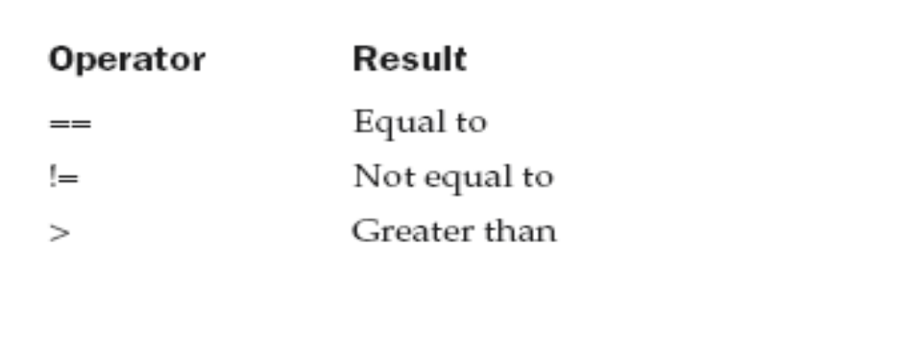
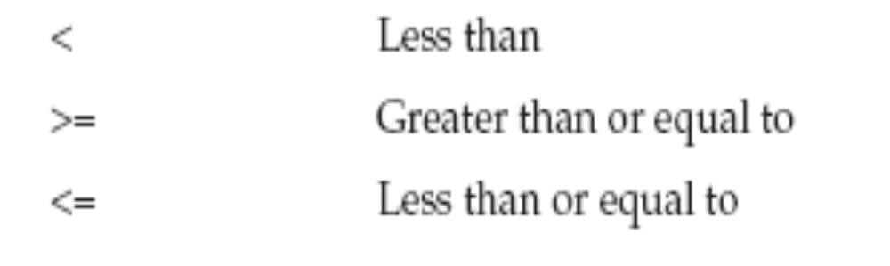
Relational Operators
August 6, 2009

Slide 23
int a = 4;
int b = 1;
boolean c = a < b;
int done;
// ...
if(!done) ... // Valid in C/C++
if(done) ... // but not in Java.
In Java, these statements must be written like this:
if(done == 0)) ... // This is Java-style.
if(done != 0) ...
August 6, 2009

Slide 24
In Java, true and false are nonnumeric values which do not relate to zero or nonzero
August 6, 2009

Slide 25
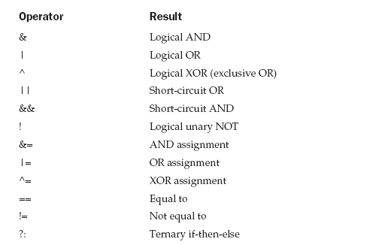
Boolean Logical Operators
August 6, 2009

Slide 26
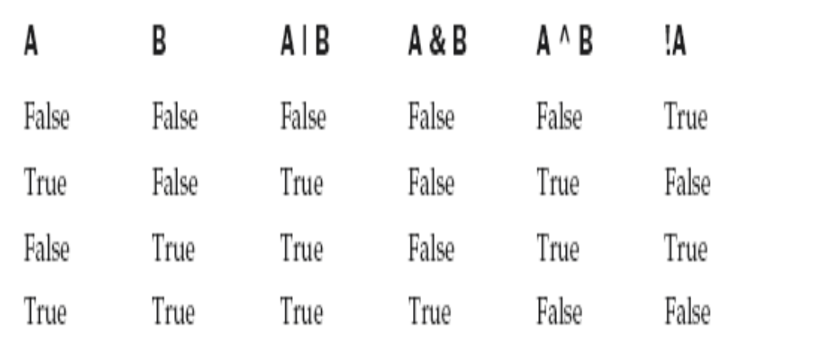
August 6, 2009

Slide 27
Short-Circuit Logical Operators
Java will not bother to evaluate the right-hand operand when the outcome of the expression can be determined by the left operand alone
Example 1:
if (denom != 0 && num / denom > 10)
Example 2:
if(c==1 & e++ < 100) d = 100;
August 6, 2009

Slide 28
The Assignment Operator
var = expression;
int x, y, z;
x = y = z = 100; // set x, y, and z to 100
August 6, 2009

Slide 29
The ? Operator
expression1 ? expression2 : expression3
Example:
ratio = denom == 0 ? 0 : num / denom;
August 6, 2009

Slide 30
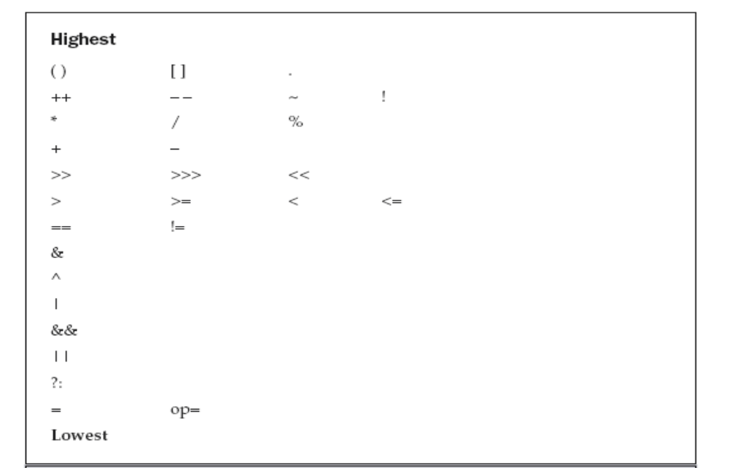
Operator Precedence
August 6, 2009

Slide 31
Example:
a | 4 + c >> b & 7
(a | (((4 + c) >> b) & 7))
August 6, 2009

Slide 32
Parentheses (redundant or not) do not degrade the performance of your program
Therefore, adding parentheses to reduce ambiguity does not negatively affect your program
August 6, 2009

